Slide 1
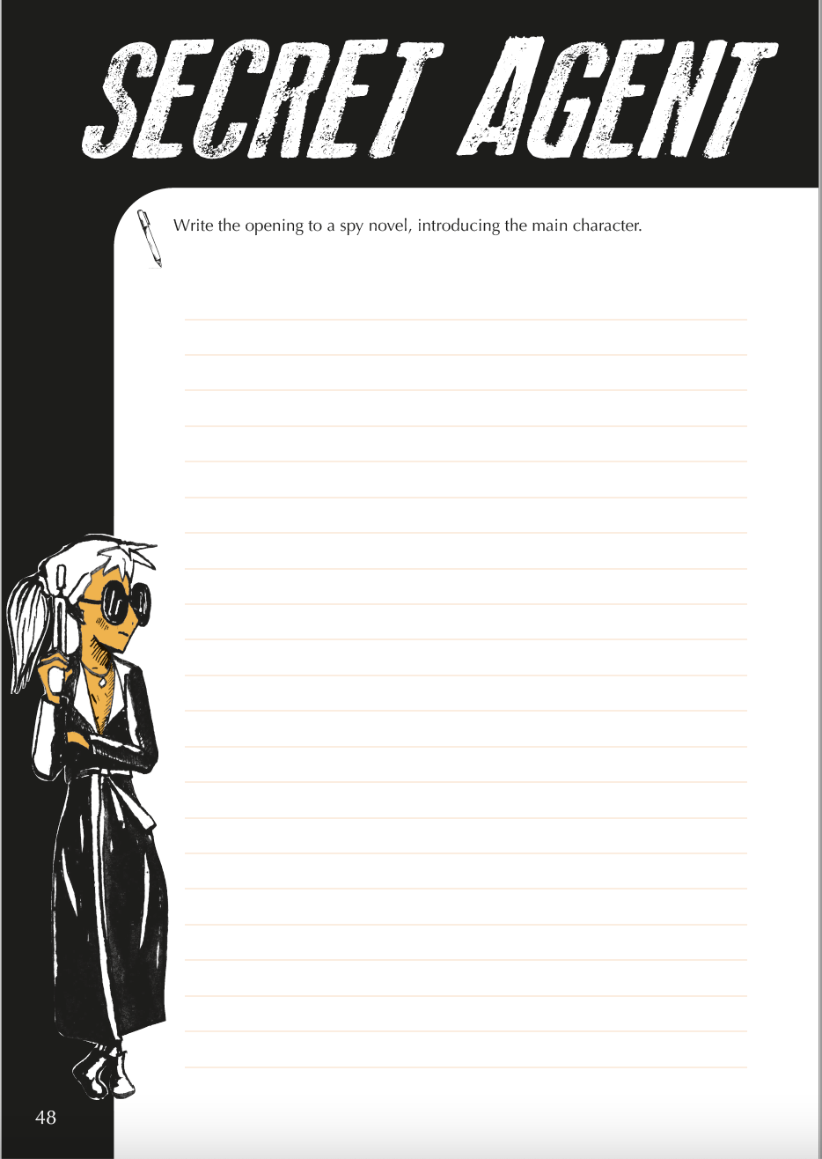
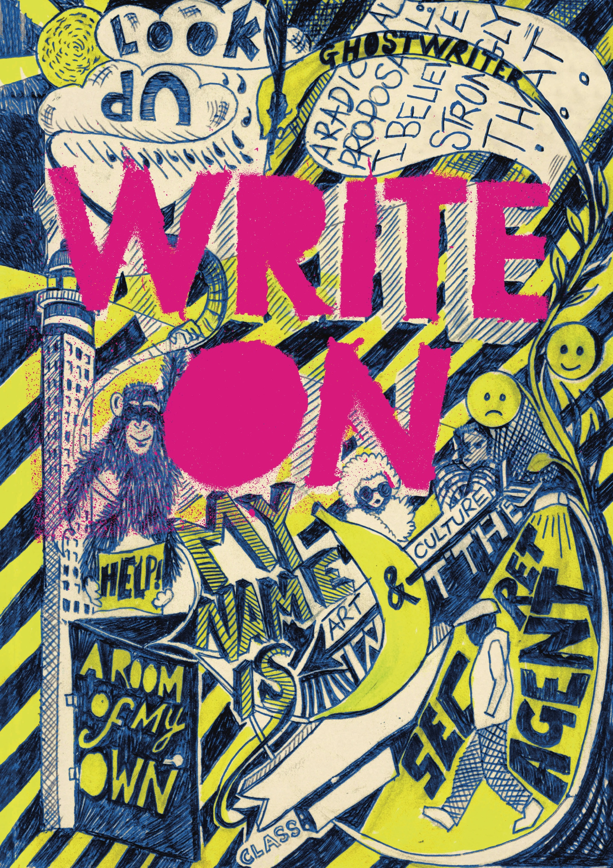
Write On
online
Secret Agent
Write the opening to a spy novel, introducing the main character.

Slide 2
Who’s your spy? Creating a spy profile
What sort of spy will you create? Use the prompts below to help you build up a sense of your character.
  Codename?
  Strengths?
  Vulnerabilities?
  Favourite gadget?
  What or who do they fear?
  Who are they working for?
  Who are they spying on?
  What is their mission?

Slide 3
Grabbing the reader’s attention
On the next slide are the opening lines to ten spy novels – from classics such as James Bond to recent novels for young adults. (You can find out the authors and titles on slide 8.)
Read the different openings and choose the one that most makes you want to read on.
Share your choices in chat, with your reasons.
Stretch your spy-writing muscles by writing the next couple of sentences for the opening you chose. Try to imitate the style as closely as possible.
Scroll through chat to see how other people have continued the openings. Choose one or two you think work particularly well and explain why.

Slide 4
The Secret Service holds much that is kept secret even from very senior officers in the organisation. Only M and his Chief of Staff know absolutely everything there is to know.
I returned from the City about three o’clock on that May afternoon pretty well disgusted with life.
The truth is, if old Major Dover hadn’t dropped dead at Taunton races Jim would never have come to Thursgood’s at all.
‘How long have we been sitting here?’ I said. I picked up the field glasses and studied the bored young American soldier in his glass-sided box.
‘Nearly a quarter of a century,’
When the doorbell rings at three in the morning, it's never good news.
How does one describe Artemis Fowl? Various psychiatrists have tried and failed.
I wanted to be heroic and I pretended I was.
It’s hard to smile when you’re having dinner with Nazis.
I scanned the room I was about to break into from the inside of the ventilation shaft.
It is cold at six-forty in the morning of a March day in Paris, and seems even colder when a man is about to be executed by firing squad.

Slide 5
Bringing your spy to life
Drawing on your spy profile and using what you have learned from the spy novels on the previous page, write the first paragraph of your own novel.
Don’t worry about getting it exactly right – this is only a first draft.
Read over your draft and identify at least one thing you really like about it.
Share both your draft opening and your comment on it in chat.

Slide 6
Even James Bond got re-drafted!
The extracts below show the way in which Ian Fleming redrafted the opening sentence of the first James Bond novel, Casino Royale.
Read the three versions and in chat comment on the changes Fleming made.
Use your experience of looking at these drafts to think about how you might alter your own work.
You can read the novelist Antony Horowtiz’s thoughts on the different versions here: https://www.waterstones.com/blog/the-birth-of-a-legend-anthony-horowitz-on-ian-flemings-casino-royale
Draft 1: Scent and smoke and sweat hit the taste buds with an acid thwack at three o’clock in the morning.
Draft 2: Scent and smoke can suddenly combine together and hit the taste buds with an acid shock at three o’clock in the morning.
Final: The scent and smoke and sweat of a casino are nauseating at three in the morning. Then the soul-erosion produced by high gambling – a compost of greed and fear and nervous tension – becomes unbearable and the senses awake and revolt from it.

Slide 7
It’s time to WRITE ON!
Write the opening to a spy novel, introducing the main character.

Slide 8
The Secret Service holds much that is kept secret even from very senior officers in the organisation. Only M and his Chief of Staff know absolutely everything there is to know. (Ian Fleming: The Man with the Golden Gun, 1965)
I returned from the City about three o’clock on that May afternoon pretty well disgusted with life. (John Buchan: The Thirty-Nine Steps, 1915)
The truth is, if old Major Dover hadn’t dropped dead at Taunton races Jim would never have come to Thursgood’s at all. (John le Carré: Tinker, Tailor, Soldier, Spy, 1974)
‘How long have we been sitting here?’ I said. I picked up the field glasses and studied the bored young American soldier in his glass-sided box.
‘Nearly a quarter of a century,’ (Len Deighton: Berlin Game, 1983)
When the doorbell rings at three in the morning, it's never good news. (Anthony Horowitz: Stormbreaker, 2000)
How does one describe Artemis Fowl? Various psychiatrists have tried and failed. (Eoin Colfer: Artemis Fowl, 2001)
I wanted to be heroic and I pretended I was. (Elizabeth Wein: Code Name Verity, 2012)
It’s hard to smile when you’re having dinner with Nazis. (Alan Gratz: Projekt 1065, 2018)
I scanned the room I was about to break into from the inside of the ventilation shaft. (Meghan Rogers:, Crossing the Line 2016)
It is cold at six-forty in the morning of a March day in Paris, and seems even colder when a man is about to be executed by firing squad. (Frederick Forsyth: The Day of the Jackal, 1967)

Slide 9

44 creative tasks to develop students’ writing muscles
Write On is designed to give older secondary students the space and freedom to hone their writing skills through guided experimentation. By completing a number of beautifully illustrated activities, students:
develop the ability to write for multiple audiences and purposes;
learn how to think and plan for a wide range of writing tasks;
build confidence to tackle unseen GCSE writing tasks with originality and flair.
Available at https://www.englishandmedia.co.uk/publications/write-on-print

