Slide 1
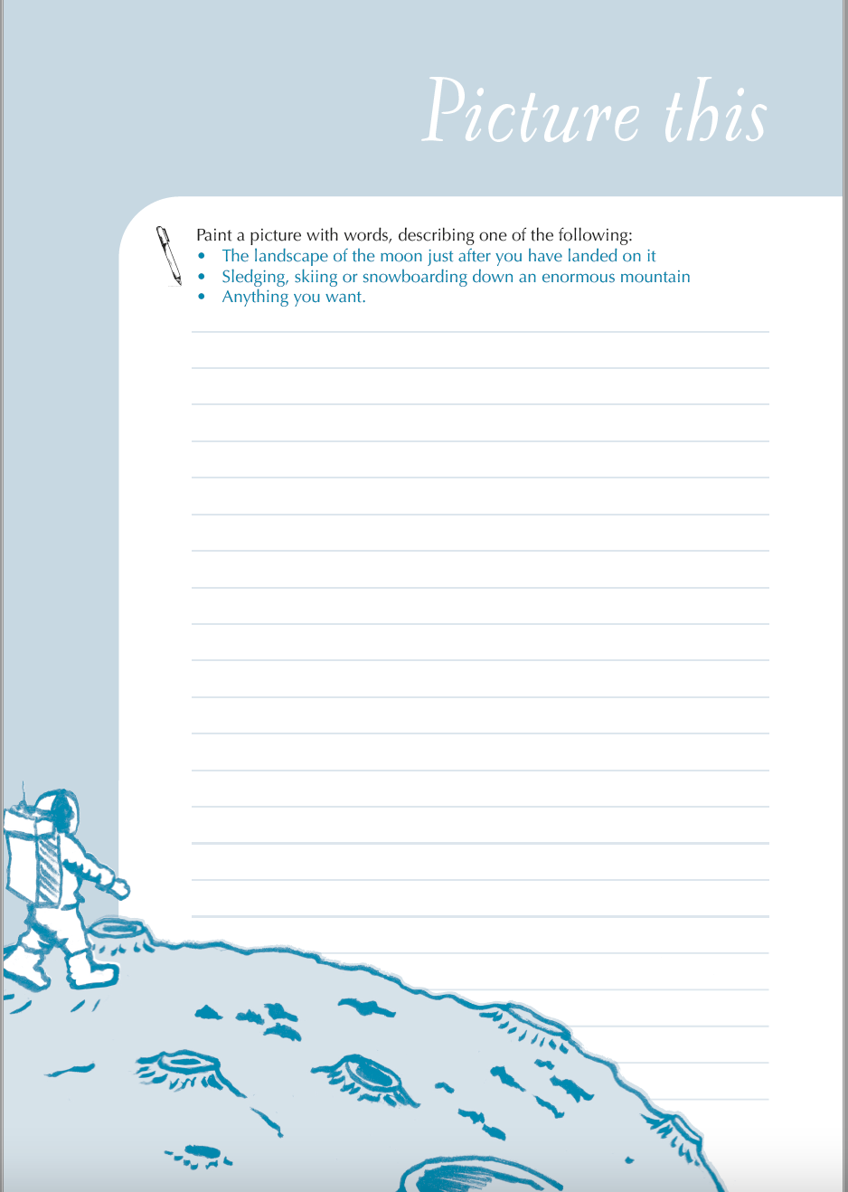

Just Write online
Picture this
Paint a picture in words, describing one of the following:
The landscape of the moon just after you have landed on it
Sledging, skiing or snowboarding down an enormous mountain
Anything you want

Slide 2
The landscape of the moon
Here are three accounts of walking on the moon, from actual astronauts.
Write the letter of the one you like best (A,B,C) in chat and explain why.
B.
The immediate surface was very powdery, as best we could see looking down from 15 feet. Off in the distance was a very clear horizon, maybe with a boulder. And, of course, the brightness of the sunlit surface was almost like looking out at sunlit snow. Your pupils close down, just as in orbit when the sun is on the spacecraft. The sky is black as can be, but there's no way you can see stars. They're there, of course, but you can't make them out because they're too faint with all the ambient light in your eyes. I was impressed with the total 'magnificent desolation' I saw in front of me: black sky, no stars and the horizon clearly curving away. (Buzz Aldrin, Apollo 11, 1969)
A.
Once I finally stepped on the moon, no matter what was to come of the next three days - or the rest of my life - nobody could take those steps from me. People ask how long will they be there, and I say forever … As I stepped on the ladder, I looked back at Earth in all its splendour - I call it sitting on God’s front porch, looking home - then down at my last footprint and realized, 'Hey, I’m not coming this way again.' It’s not like going to Grandma’s farm, like I did as a kid, and coming back next summer. (Gene Cernan, Apollo 17, 1972)
C
My most vivid memory on the moon is the beauty: the stark contrast between the brilliant grey of the moon and the blackness of space. The gray was so bright it was almost white - a sharp break between the surface and the horizon. The sun was always shining, so you didn’t see stars or planets. You could see Earth, but where we were - a little south of the centre of the moon - it was difficult. Earth was directly overhead, and, when I looked up, I saw the top of my helmet!” (Charlie Duke, Apollo 16, 1972)

Slide 3
The landscape of the moon: what’s there
Now re-read the three extract and identify what the astronauts are writing about. It could be details of the moon itself, but it could be about other things they see, memories, themselves, and so on.
Write down everything you spot in chat.
A.
Once I finally stepped on the moon, no matter what was to come of the next three days - or the rest of my life - nobody could take those steps from me. People ask how long will they be there, and I say forever … As I stepped on the ladder, I looked back at Earth in all its splendour - I call it sitting on God’s front porch, looking home - then down at my last footprint and realized, 'Hey, I’m not coming this way again.' It’s not like going to Grandma’s farm, like I did as a kid, and coming back next summer. (Gene Cernan, Apollo 17, 1972)
B.
The immediate surface was very powdery, as best we could see looking down from 15 feet. Off in the distance was a very clear horizon, maybe with a boulder. And, of course, the brightness of the sunlit surface was almost like looking out at sunlit snow. Your pupils close down, just as in orbit when the sun is on the spacecraft. The sky is black as can be, but there's no way you can see stars. They're there, of course, but you can't make them out because they're too faint with all the ambient light in your eyes. I was impressed with the total 'magnificent desolation' I saw in front of me: black sky, no stars and the horizon clearly curving away. (Buzz Aldrin, Apollo 11, 1969)
C
My most vivid memory on the moon is the beauty: the stark contrast between the brilliant grey of the moon and the blackness of space. The gray was so bright it was almost white - a sharp break between the surface and the horizon. The sun was always shining, so you didn’t see stars or planets. You could see Earth, but where we were - a little south of the centre of the moon - it was difficult. Earth was directly overhead, and, when I looked up, I saw the top of my helmet!” (Charlie Duke, Apollo 16, 1972)

Slide 4
It’s time to JUST WRITE!
Paint a picture in words, describing one of the following:
The landscape of the moon just after you have landed on it
Sledging, skiing or snowboarding down an enormous mountain
Anything you want

Slide 5

A beautifully-illustrated workbook offering 44 writing activities drawing on principles of creativity, freedom and choice.
From speeches to poems, playscripts to novel openings, this is a workbook both to harness pupils’ enthusiasm for writing and to develop their writing ‘muscles’!
Available at https://www.englishandmedia.co.uk/publications/just-write-emc-let-them-loose

