Slide 1

It’s Good to Talk – Developing Group Work in English
ResearchEd Presentation
Sat 9th September 2017

Slide 2
What kind of research?
Subject-based research into pedagogy
Not a large RCT research project
Questions before answers
Recognising the complicated, multifactorial nature of classrooms
Avoiding making exaggerated claims

Slide 3
Group work – beyond broad ‘strategies’
Structures for group work – jigsaws, socratic circles, home/expert groups, envoys, snowballing etc
Group roles – note-taker, facilitator, chair etc
Groupings – friendship, ability, behaviour, random, varied or not
Size of groups – pros and cons of pairs, 3s, 4s or larger
Procedures/etiquette for good group work – establishing shared ground rules, talk protocols etc

Slide 4
Our Project – taking it further to develop group work practices in English classrooms
Can collecting examples of group work in action help show what it can achieve & uncover what it means to do it well?
Can we go beyond the commonly known ‘strategies’ and the ’tips’ for good group work to something more subtle & sophisticated?
Can teachers be supported in analysing group work & making evaluative judgements about it, as well as how and when to intervene?
Can we refine the use of group work in English classrooms to make it more productive?

Slide 5
10 Themes from EMC Group Work Research Project
What kinds of things is group work good for, and conversely, what kinds of things isn’t it good for?
What’s the role of the teacher?
The role of report-backs and whole class feedback
Timing and pacing of group work (including sequencing in the lesson)
What if students don’t seem to be making good progress all the time?
What kind of tasks work best in group work?
What’s the right level of challenge in group work?
What insights does group work offer the teacher into how and what children are learning?
What’s the value of creative work in group work on texts?
Setting v mixed ability – what difference does this make?

Slide 6
Group work on poetry – falcon poems
Who would you give these poems to? What year?
What would you do with the poems? What kinds of activities/approaches?
What difficulties do you think the students would have?
What would you hope that they might learn about poetry?

Slide 7
And the Falcon Came
Ted Hughes
&
The Falcon to the Falconer
Jonathan Steffen

Slide 8
Falcon Poems – the activities
5 mins looking at still images of falcons – whole class
Home groups on different poems, each with a set of statements – agree/disagree/not sure. Pick 3 they most agree with, 1 they most disagree with. A few groups worked more on their own, with some statements being fed in if they asked for some support or prompts but not otherwise. (20 mins)
Re-jigged into expert groups on both poems, looking at similarities and differences. (20 mins)
Report-back to whole class (15 mins)
Expressive writing – a free chance to express thoughts, ideas, uncertainties in whatever way they wanted. (20 mins)

Slide 9
CLIP 11 Home groups talk about the poems, with statements
VIDEO

Slide 10
CLIP 12 Expert groups share their poems and compare
VIDEO

Slide 11
CLIP 14 Feedback to whole class
VIDEO

Slide 12
What the students said
‘I preferred doing harder tasks as they made me think in ways I have never thought.’
‘ ‘I prefer the tasks where you are left more on our own…because it gets your brain up and working.’
‘I liked it because I got to use my mind and think more outside the box for myself. It helped me explain things out loud that you thought in your head.’
Many liked tasks where left to work together in groups:
  ‘because I’m the person finding out. I’m exploring into the poem.’
  ‘then we could use our imagination and do it ourselves.’

Slide 13
Teachers’ reflections
VIDEO

Slide 14
New aspects of our work
Logging group work
  How much is done by teachers across a dept?
  With which year groups & students?
  % of lesson
  Sequence within lesson
  Implications?
Interventions in group work
  14 different reasons to intervene/ways of intervening
  Which do you habitually use?
  What happens if you intervene in different ways?

Slide 15
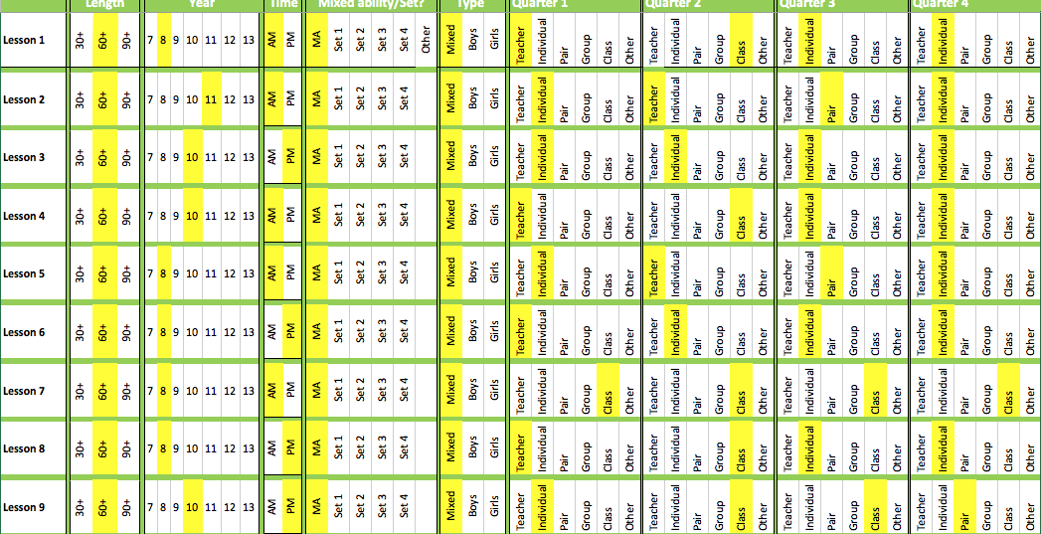
Logging Group Work

Slide 16
14 ways of intervening in group work
1. Pausing to share great ideas & give other groups a sense of what’s possible.
2. Pausing to push thinking further, in directions you think it should be going in.
3. Challenging ideas – not ‘anything goes’
4. Correcting a misunderstanding
5. Adding a new dimension, or fresh bit of information
6. Acting as devil’s advocate
7. Putting your own view
Plus 7 more….

Slide 17
For more information, or to get involved, contact:
barbara@englishandmedia.co.uk
It’s Good to Talk Project Page:
www.englishandmedia.co.uk/cpd-and-consultancy/our-projects/its-good-to-talk-developing-group-work-in-english

